Slide 1

Predicting Heart Attacks using Machine Learning (binary classification problems)
Frank Williams
Adrian Torres
Paige Madison

Slide 2
Data Origin
The survey data comes from the CDC’s Behavioral Risk Factor Surveillance System and was collected in 2023 and was collected from all 50 states.
The data does not have any Na values, but we did double check.
Notes:
The dataset covers factors relevant to heart disease, including high blood pressure, high cholesterol, smoking, diabetes status, obesity, physical activity, and alcohol consumption, sourced from the CDC's Behavioral Risk Factor Surveillance System (BRFSS) annual telephone surveys across the United States.
The recent dataset, from 2023, has been refined to include the most relevant variables totaling 40 and is available both with and without missing values, originating from the CDC's BRFSS, which conducts over 400,000 adult interviews yearly, providing a comprehensive overview of health status in the United States.
The dataset can be utilized for various purposes, particularly for applying machine learning techniques such as logistic regression, support vector machines (SVM), and random forest classifiers, with the variable "HadHeartAttack" treated as binary and techniques such as fixing weights or undersampling recommended due to class imbalance, with a logistic regression model already constructed and integrated into an application for heart condition assessment.

Slide 3
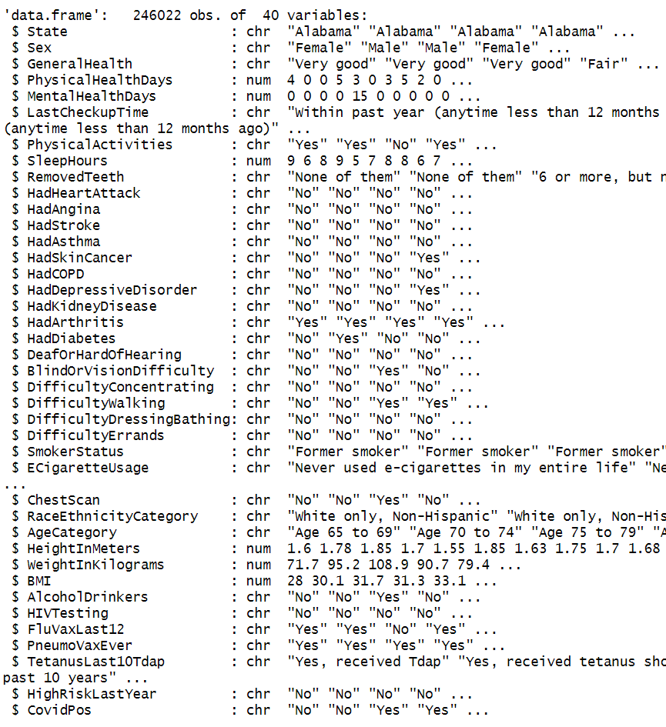
Data Structure

Slide 4
Subset Data Structure
Observations: 246,022
Columns: 37
Length of cat_cols: 31 (Text)
Length of num_cols: 6 (Numeric)
Length of dbl_cols: 6 (Decimal Numeric)
Total number of columns in data_train: 37

Slide 5
Steps to Complete
1. Define the Problem
2. Gather Data
3. Data Preprocessing
4. Exploratory Data Analysis (EDA)
5. Feature Selection/Extraction
6. Model Selection
7. Model Training
8. Model Evaluation
9. Iterate and Improve
10. Documentation and
Communication

Slide 6
Main Questions(Defining the Problems)
Can we accurately predict heart attacks?
Which variables are the most important for predicting heart attacks?
Are non-biological ailments, like depression, important for predicting heart attacks?

Slide 7
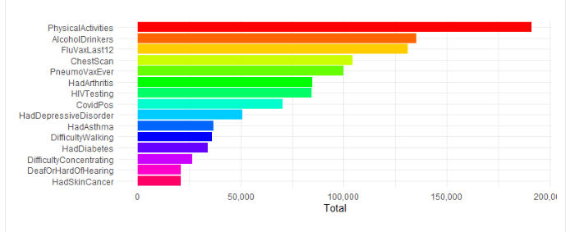
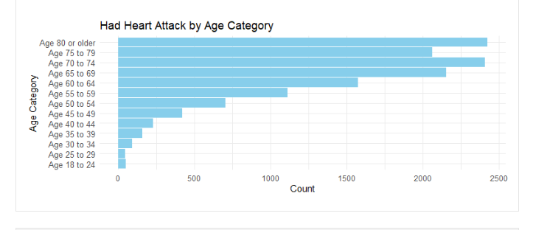
Exploratory Data Analysis: Visualizations
Top 15 Columns - This visualization provides the top 15 columns that frequently coincide with users who have experienced a heart attack.
Top 15 Columns
Had Heart Attack by Age Category - Individuals aged 70-74 and those aged 80 or above constituted the highest proportions of heart attack cases.

Slide 8
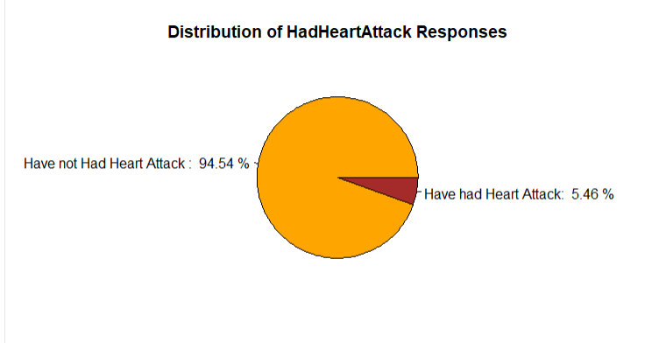
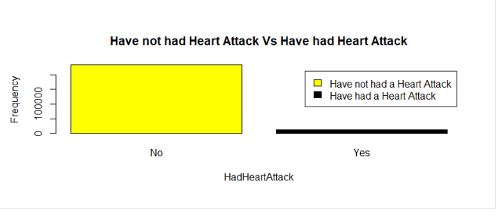
Exploratory Data Analysis: Visualizations
94.54 % Had not had Heart Attacks
5.46 % Have had Heart Attacks
232,587 Had not had Heart Attacks
13,435 Have had Heart Attacks

Slide 9
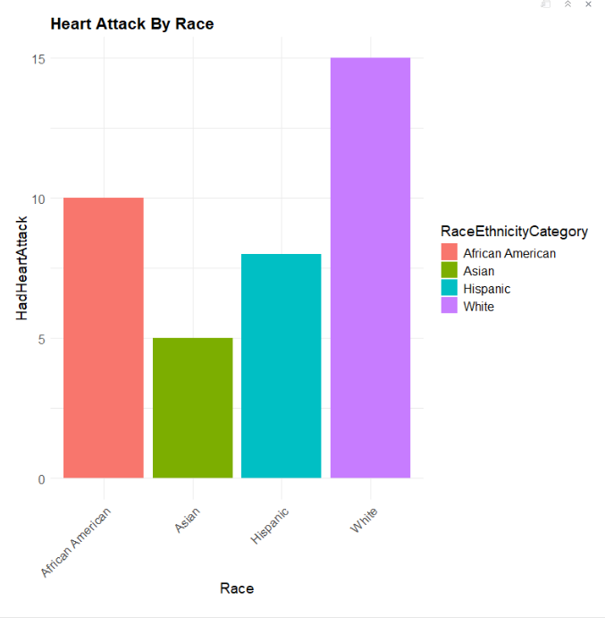
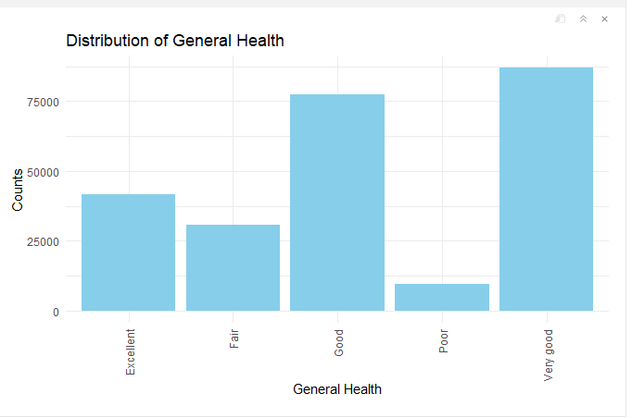
Exploratory Data Analysis: Visualizations
Heart Attack By Race - a higher prevalence of heart attacks among white patients, followed by African Americans.
Distribution of General Health - 83.7% of patients reported health statuses ranging from Good to Excellent. Conversely, 16.3% of patients indicated their health status as Poor or Fair.

Slide 10
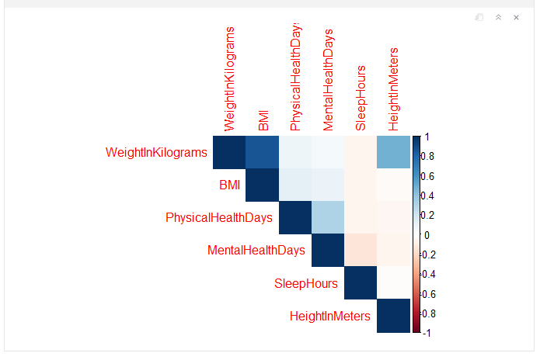
Exploratory Data Analysis: Visualizations
Correlation Statistics
Correlation Statistics
The variables WeightInKilograms, BMI, and Physical health days exhibited positive correlations, as depicted in the matrix.
This addresses two of the questions we aimed to answer, providing the top three variables that are most correlated with predicting heart attacks.

Slide 11
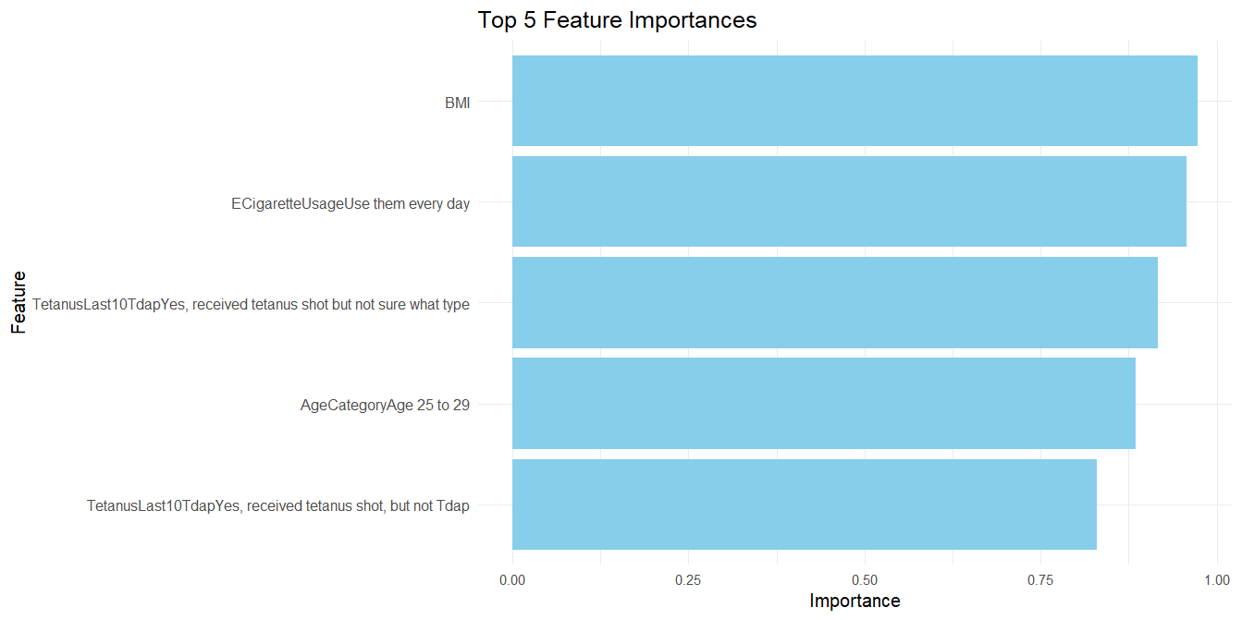
Exploratory Data Analysis: Visualizations
The following variables exhibited the lowest p-values, indicating their significant impact on predicting heart attacks in the undersampled logistic regression model. These variables are ranked as the most significant predictors.

Slide 12
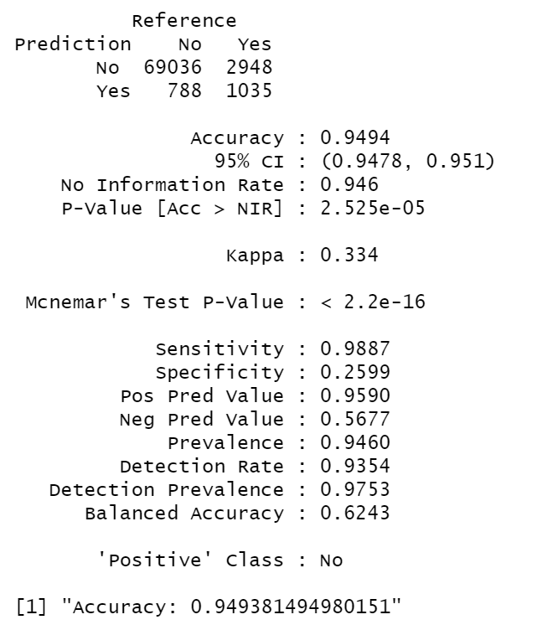
Logistic Regression Model Creation and Output
# Model training# Fit logistic regression model
model <- glm(HadHeartAttack ~ ., data = train_data, family = binomial)
As can be seen in our output, we achieved an accuracy score of 94.94%.

Slide 13
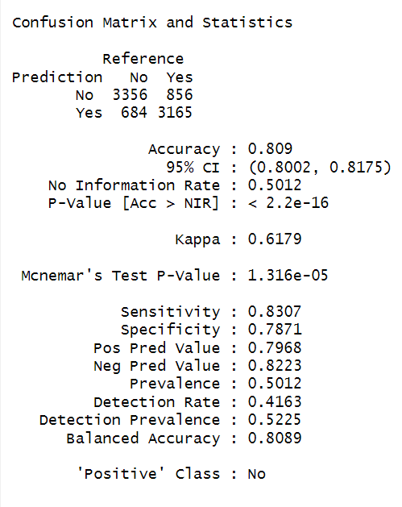
Logistic Model( undersampling majority class)Output
After, undersampling the “No” response the accuracy score dropped to 80.9%, which showed that the over prevalence of the “No” response influenced the accuracy.

Slide 14
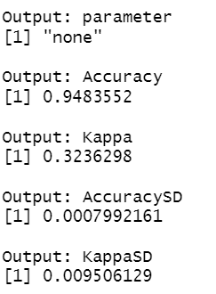
Alternate Model Outputs
As can be seen in the pictures of the model outputs, the accuracy metrics are very similar, but the K-fold version of the logistic regression model is slightly better.
K-Fold Logistic Regression Model
Logistic Regression Model

